Slide 1
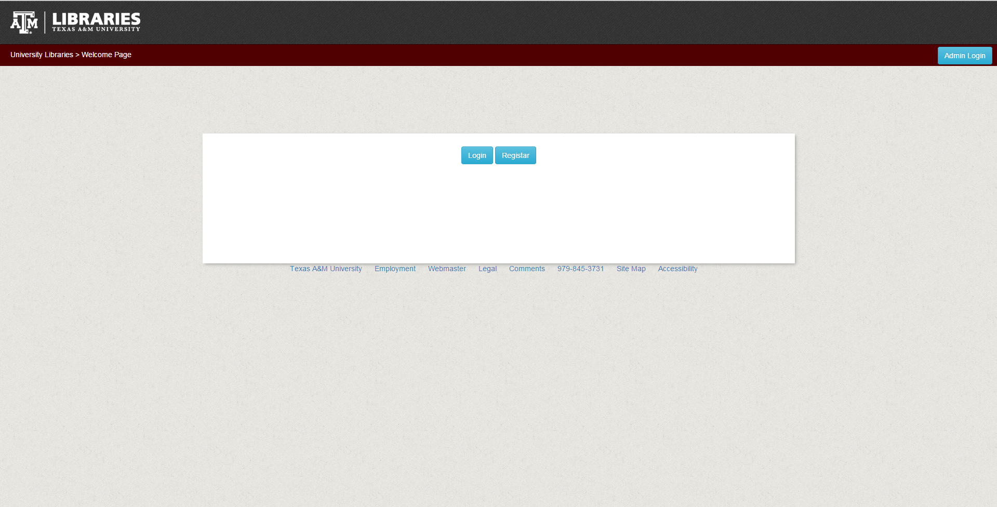
1: You can click on register
2: You can click on Login
3: You can clock on Admin Login if you are an Admin fir the Website

Slide 2
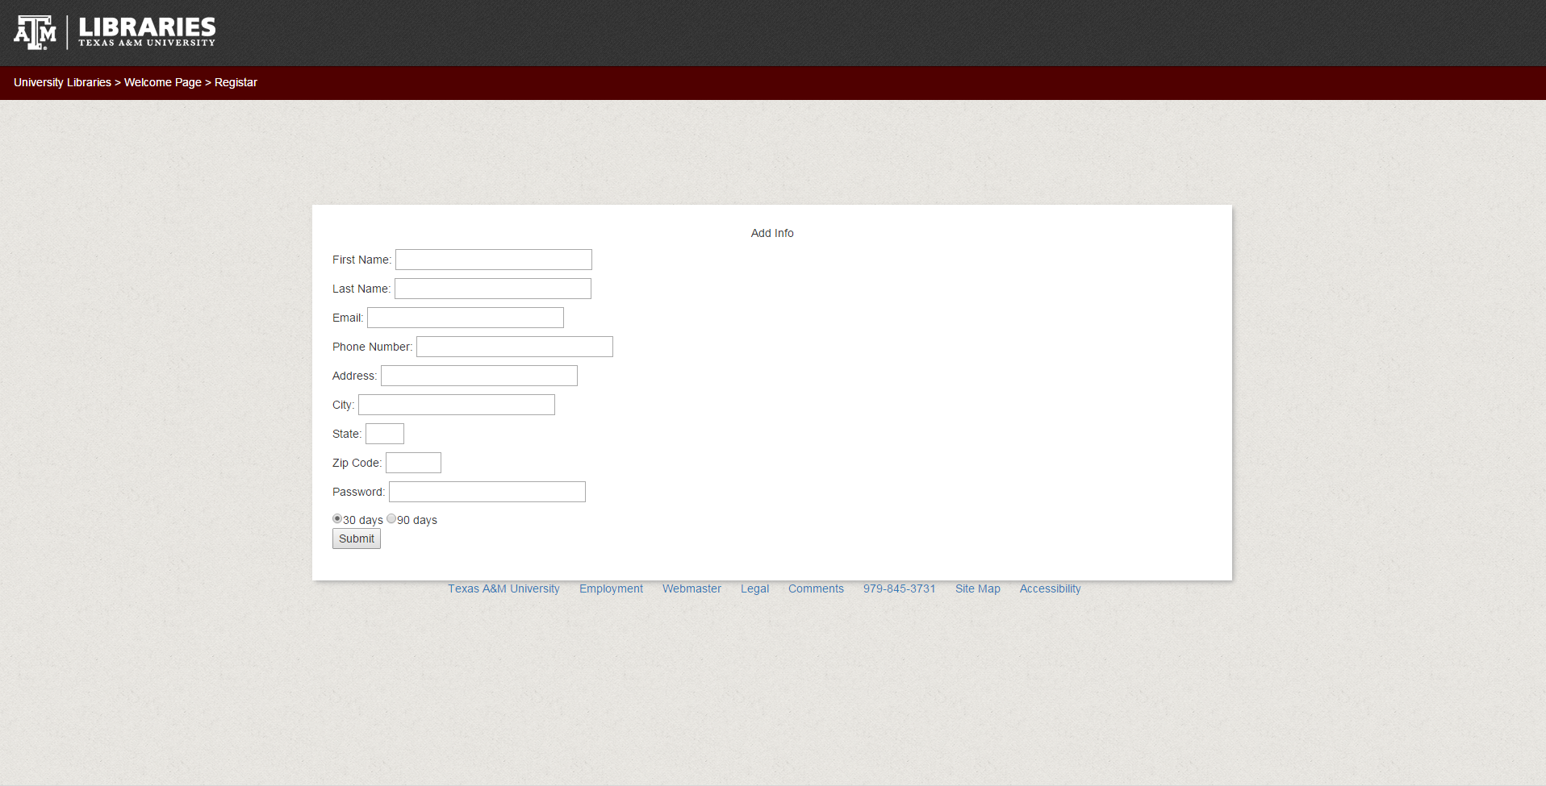
Option: 1
Fill in the data and a password and determine if you want a 30day or 90day account the click submit

Slide 3
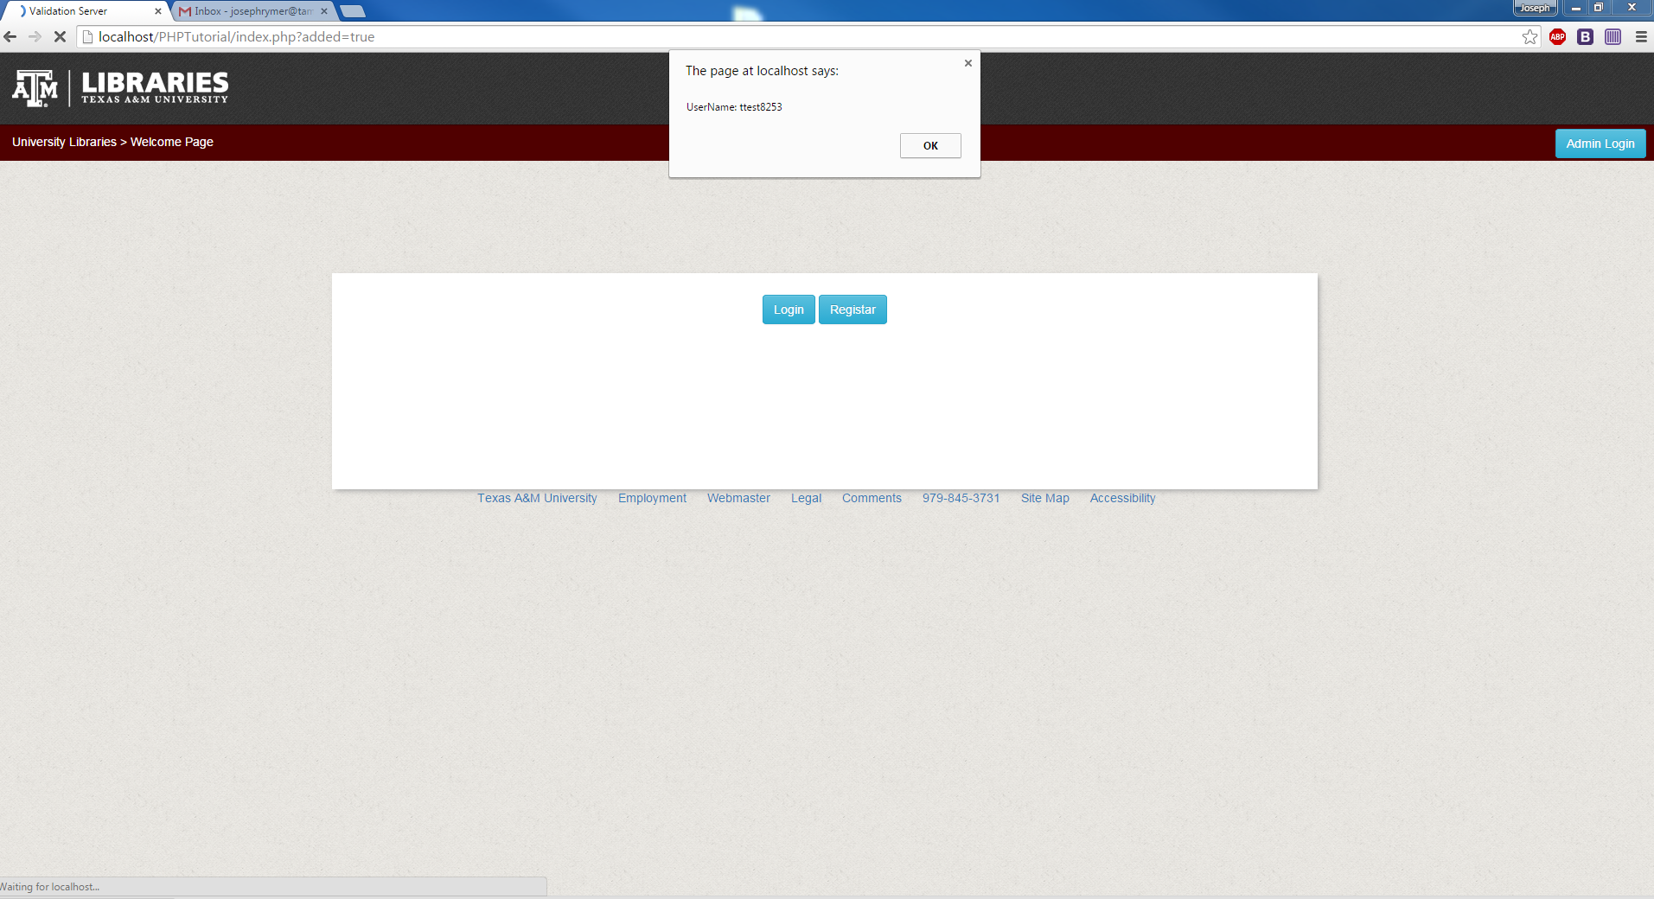
After Clicking submit a message will pop with your username for logging in
You should write this down if you don’t have good memory

Slide 4
Once option 1 is complete and you have clicked ok on the message box go ahead and clock on login

Slide 5
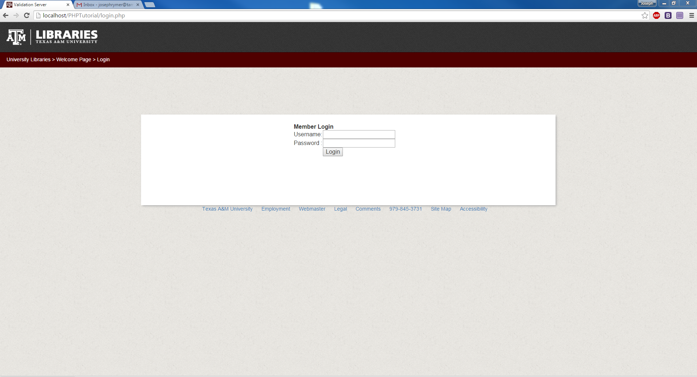
On this screen go ahead and under username put in your username given to you earlier as well as the password you set and then click login

Slide 6
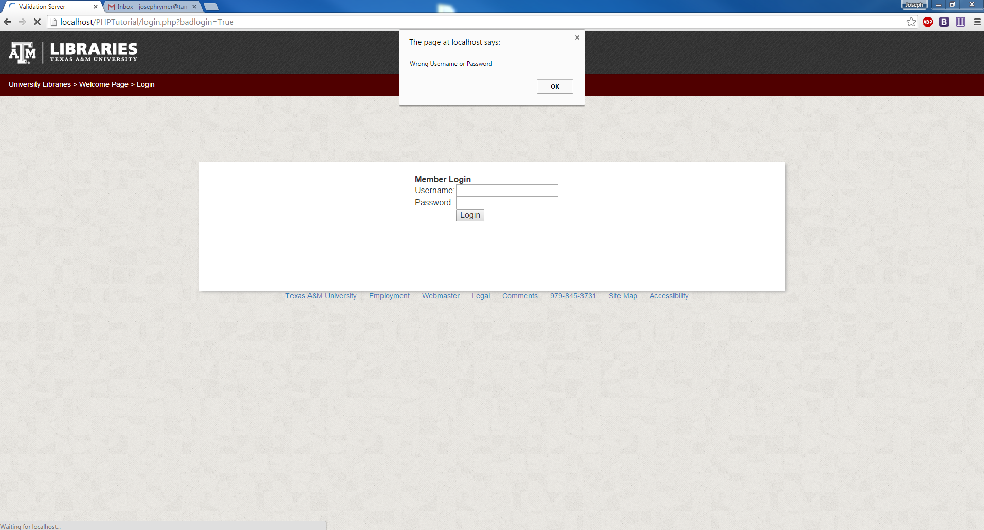
If put the data in wrong you will get this message click ok to try it again if the problem persist send a message to the admin vie the phone number at the bottom

Slide 7
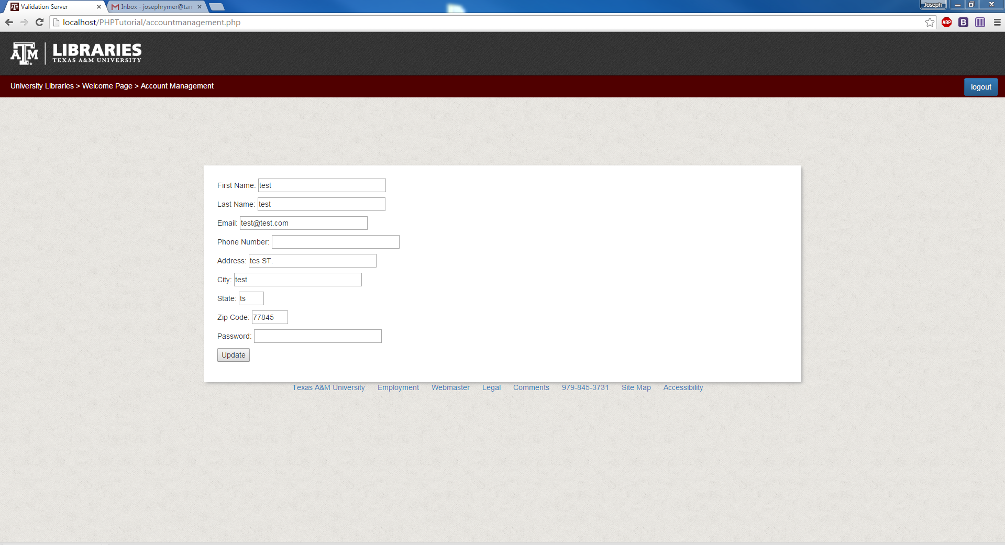
Once you have logged in successfully it will direct you to this page where you can either logout or you can change your data by deleting what's in the data field and replacing it with something else and then clocking update

Slide 8
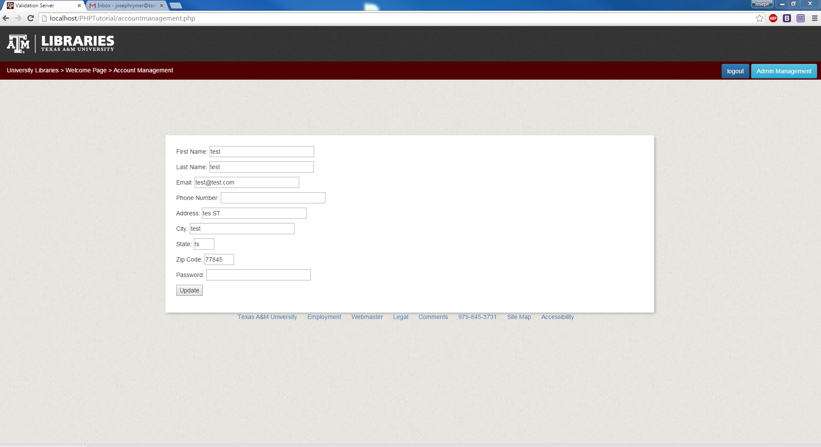
If you are an admin then you will get a button with a title called admin management which you can click to go to the admin management end of the website and database

Slide 9
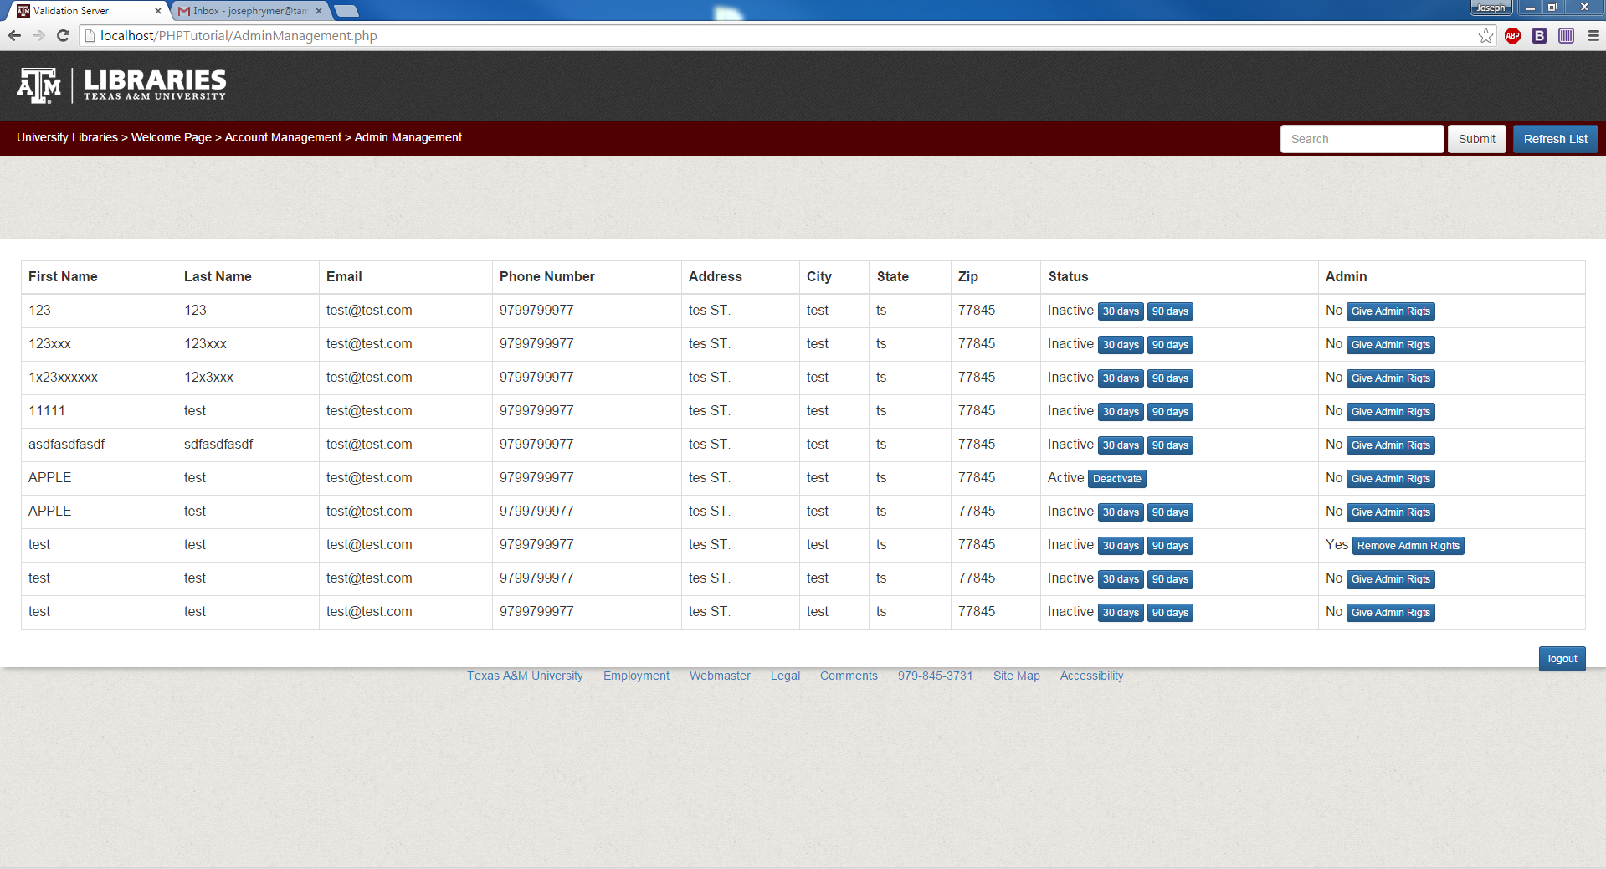
As and admin you have many options first you can refresh the list after you have made some changes or to get the current info you can also deactivate a user by clicking on the deactivate as well as you can activate a user for 30 or 90days by clicking on 30 or 90days you can aslo do a search for users as well as you can logout on the bottom of the page.

Slide 10
Clicking on Admin Login will redirect you to a similar login but one specifcally built for the admin of the webpage

Slide 11
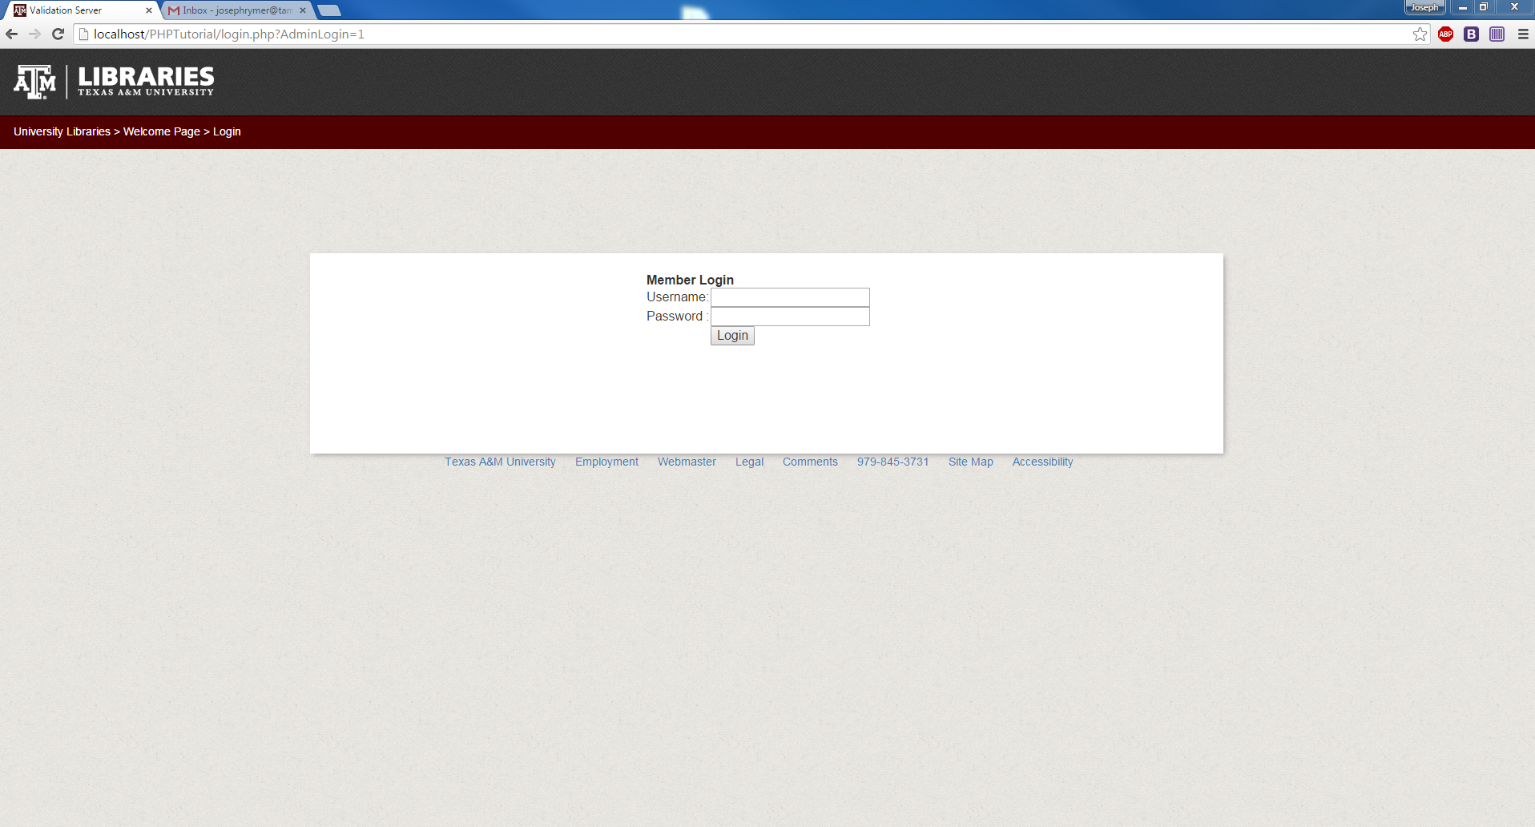
As an Admin Login you just need to put in your credentials and login which you should then go back to slide 9 on what to do after you click login.

